Slide 1

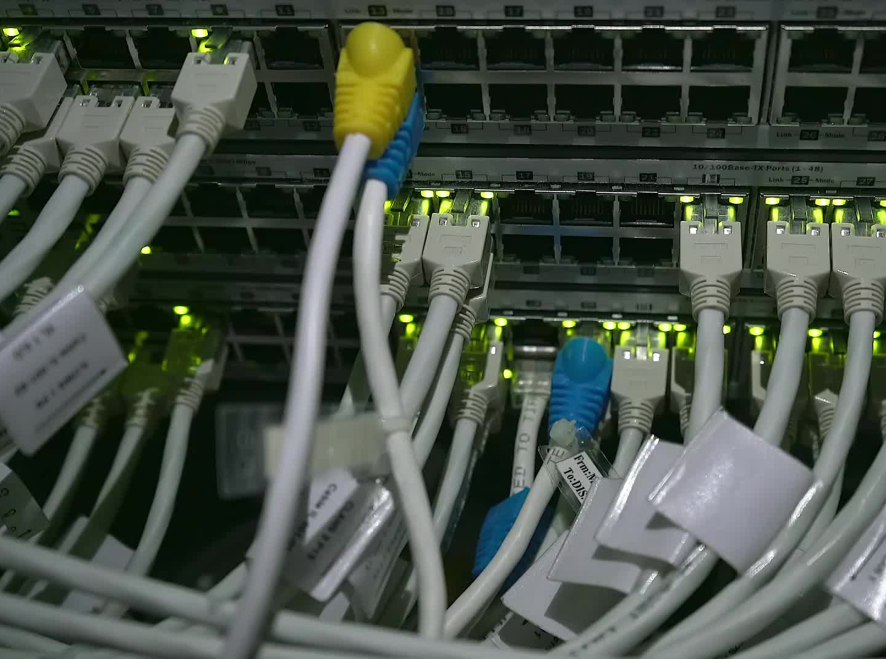


CS621 Parallel and Distributed Computing
Dr. Muhammad Anwaar Saeed
Dr. Said Nabi
Ms. Hina Ishaq

Slide 2
CS621 Parallel and Distributed Computing
Introduction to Fault Tolerance

Slide 3
Objectives
Introduction of Fault Tolerance.
Fault Classification.
Failure Masking.
Failure Classification.

Slide 4
Fault Tolerance
“A fault-tolerance system is one that continues to provide the required functionality in the presence of fault/failure.”

Slide 5


Fault Tolerance Cont…
A characteristic feature of distributed systems is the notion of partial failure:
An important goal in distributed systems design is to construct the system in such a way that it can automatically recover from partial failures without seriously affecting the overall performance.
A partial failure may happen when one component in a distributed system fails.
This failure may affect the proper operation of other components, while at the same time leaving yet other components totally unaffected.

Slide 6
Fault Classification
Faults are generally classified as transient, intermittent, or permanent:
Transient fault: Occurs once and then disappear. If the operation is repeated, the fault goes away.
Intermittent fault: Occurs, then vanishes of its own accord, then reappears, and so on. A loose contact on a connector will often cause an intermittent fault.
Permanent fault: Is one that continues to exist until the faulty component is replaced. Burnt-out chips, software bugs, and disk head crashes are examples of permanent faults.

Slide 7
Failure Classification
Faults are generally classified into five categories:
Crash failure: A server halts but working correctly until it halts.
Omission failure: A server fails to respond to incoming requests.
Response failure: A server’s response is incorrect.
Arbitrary failure: A server may produce the arbitrary responses at arbitrary times.
Timing failure: A server’s response lies outside the specified time interval.

Slide 8
Failure Masking
“Failure masking is a fault tolerance technique that hides occurrence of failures from other processes.”

Slide 9
Failure Masking Cont…
The most common approach to failure masking is redundancy which is categorized into three types:
Information redundancy: Add extra bits to allow recovery from garbled bits.
Time redundancy: Repeat an action if needed.
Physical redundancy: Add extra equipment or processes so that the system can tolerate the loss or malfunctioning of some components.

Slide 10
CS621 Parallel and Distributed Computing
Process Resilience

Slide 11
Objectives
Introduction of Process Resilience.
Flat Groups versus Hierarchical Groups.
Failure Masking and Replications.
Approaches for Replications.

Slide 12
Process Resilience
“Process resilience incorporates techniques by which one or more processes can fail without seriously disturbing the rest of the system.”

Slide 13
Process Resilience Cont…
Related to this issue is reliable multicasting, by which message transmission to a collection of processes is guaranteed to succeed.
Reliable multicasting is often necessary to keep processes synchronized.
Protection against process failures can be achieved by process replication, organizing several identical processes into a group.
Groups are categorized into two categories: Flat Group and Hierarchy Group.

Slide 14
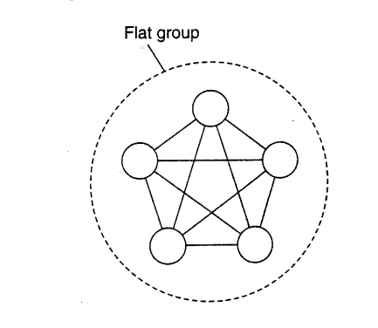
Flat Group
All processes are equal.
The processes make decisions collectively.
No single point of failure, but decision making is more complicated as consensus is required.

Slide 15
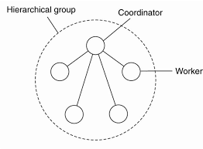
Hierarchical Group
A single coordinator makes all decisions.
Single point-of failure, however: decisions are easily and quickly made by the coordinator without first having to get consensus.
Group is transparent to its users; the whole group is dealt with as a single process.

Slide 16
Failure Masking and Replication
By organizing a fault tolerant group of processes , we can protect a single vulnerable process.
Two approaches to arranging the replication of the group are:
Primary-base protocols and Replicated-write protocols.

Slide 17
Primary-Base Protocols
Appears in the form of a primary-backup protocol.
A group of processes is organized in a hierarchical fashion in which a primary coordinates all write operations.
When the primary crashes, the backups execute some election algorithm to choose a new primary.

Slide 18
Replicated-Write Protocols
Replicated-write protocols are used in the form of active replication, as well as by means of quorum-based protocols.
Solutions correspond to organizing a collection of identical processes into a flat group.
These groups have no single point of failure, at the cost of distributed coordination.

Slide 19
CS621 Parallel and Distributed Computing
Reliable Client-Server Communication

Slide 20
Objectives
Understanding of Reliable Client-Server Communication.
RPC Semantics in the Presence of Failures.

Slide 21
Reliable Client-Server Communication
Fault tolerance in distributed systems concentrates on faulty processes.
However, communication failures should also be considered .
A communication channel may exhibit crash, omission, timing, and arbitrary failures.

Slide 22
Peer to Peer Communication
Reliable point-to-point communication is established by making use of a reliable transport protocol, such as TCP.
TCP masks omission failures, which occur in the form of lost messages by using acknowledgments and retransmissions.
Crash failures of connections are not masked. The only way to mask such failures is to let the distributed system attempt to automatically set up a new connection.

Slide 23
RPC Semantics in the Presence of Failures
Remote Procedure Call (RPC) mechanism works well as long as both the client and server function perfectly.
Five classes of RPC failure can be identified:
The client is unable to locate the server.
The request message from the client to the server is lost.
The server crashes after receiving a request.
The reply message from the server to the client is lost.
The client crashes after sending a request.

Slide 24
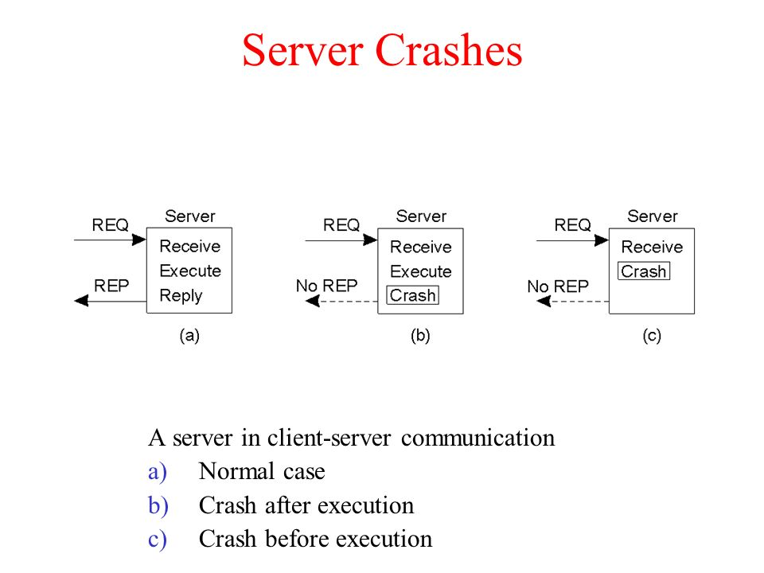
Server in Client-Server Communication
The sequence of events at a server is shown in Fig.
(a) A request arrives, is carried out, and a reply is sent.
(b) A request arrives and is carried out, just as before, but the server crashes before it can send the reply.
(c) Again, a request arrives, but this time the server crashes before it can even be carried out and no reply is sent back.

Slide 25
Server in Client-Server Communication Cont..
Server crashes are dealt with by implementing one of three possible implementation philosophies:
At least once semantics: A guarantee is given that the RPC occurred at least once, but (also) possibly more that once.
At most once semantics: A guarantee is given that the RPC occurred at most once, but possibly not at all.
No semantics: Nothing is guaranteed, and client and servers take their chances.

Slide 26
Client in Client-Server Communication
When a client sends a request to a server and crashes before the server replies.At this point a computation is active and no parent is waiting for the result. Such an unwanted computation is called an orphan. Four orphan solutions have been proposed:
Extermination: The orphan is simply killed-off.
Reincarnation: Each client session has an epoch associated with it, making orphans easy to spot.
Gentle reincarnation: When a new epoch is identified, an attempt is made to locate a requests owner, otherwise the orphan is killed.
Expiration: If the RPC cannot be completed within a standard amount of time, it is assumed to have expired.

Slide 27
CS621 Parallel and Distributed Computing
Reliable Group Communication

Slide 28
Objectives
Understanding of Reliable Group Communication.
Reliable-Multicasting Schemes.

Slide 29
Reliable Group Communication
“Reliable multicast services guarantee that all messages are delivered to all members of a process group.”

Slide 30
Basic Reliable-Multicasting Schemes
A simple solution to reliable multicasting when all receivers are known and are assumed not to fail.
The sending process assigns a sequence number to each message it multicasts.
Assume that messages are received in the order they are sent.
Each multicast message is stored locally in a history buffer at the sender.
Assuming the receivers are known to the sender, the sender simply keeps the message in its history buffer until each receiver has returned an acknowledgment.
If a receiver detects it is missing a message, it may return a negative acknowledgment, requesting the sender for a retransmission.

Slide 31
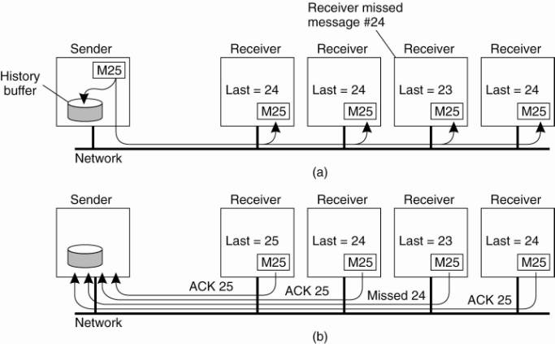
Basic Reliable-Multicasting Schemes Cont..
(a) Message transmission – note that the third receiver is expecting 24.
(b) Reporting feedback – the third receiver informs the sender.

Slide 32
CS621 Parallel and Distributed Computing
Distributed Commit

Slide 33
Objectives
Introduction of Distributed Commit.
Distributed Commit Protocol Phases.

Slide 34
Distributed Commit
“The distributed commit problem involves having an operation being performed by each member of a process group, or none at all.”

Slide 35
Distributed Commit Cont…
In the case of reliable multicasting, the operation is the delivery of a message.
With distributed transactions, the operation may be the commit of a transaction at a single site that takes part in the transaction.
Other examples of distributed commit, and how it can be solved are discussed in Tanisch (2000).

Slide 36
Distributed Commit Cont …
Commit protocol is distributed into three types:
Single-phase commit
Two-phase commit
Three-phase commit.

Slide 37
One-Phase Commit Protocol:
The solutions: Two-Phase and Three-Phase Commit Protocols
Coordinator tells all other processes that are also involved, called participants, whether to (locally) perform the operation in question.
If one of the participants cannot perform the operation, there is no way to tell the coordinator.
It cannot efficiently handle the failure of the coordinator.
The solutions:
Two-Phase and Three-Phase Commit Protocols

Slide 38
Two-Phase Commit Protocol
“Assuming that no failures occur, the protocol consists of the following two phases, each consisting of two steps: The first phase is the voting phase, and the second phase is the decision phase.”

Slide 39
Two-Phase Commit Protocol Cont…
The coordinator sends a VOTE_REQUEST message to all participants.
A group member returns VOTE_COMMIT if it can commit locally, otherwise VOTE_ABORT message.
All votes are collected by the coordinator.
A GLOBAL_COMMIT is sent if all the group members voted to commit.
If one group member voted to abort, a GLOBAL_ABORT is sent.
Group members then COMMIT or ABORT based on the last message received from the coordinator.

Slide 40
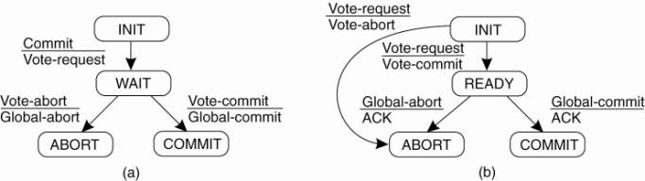
Two-Phase Commit Protocol Cont…
(a) The finite state machine for the coordinator in 2PC.
(b) The finite state machine for a participant.

Slide 41
Drawbacks of Two-Phase Commit Protocol
It can lead to both the coordinator and the participants blocking, which may lead to the dreaded deadlock.
If the coordinator crashes, the participants may not be able to reach a final decision, and they may, therefore, block until the coordinator recovers.
Two-Phase Commit is known as a blocking-commit protocol for this reason.
The solution: Three-Phase Commit Protocol

Slide 42
Three-Phase Commit Protocol
Skeen (1981) developed a variant of 2PC, called the three-phase commit protocol (3PC), that avoids blocking processes in the presence of fail-stop crashes.
The states of the coordinator and each participant satisfy the following two conditions:
There is no single state from which it is possible to make a transition directly to either a COMMIT or an ABORT state.
There is no state in which it is not possible to make a final decision, and from which a transition to a COMMIT state can be made.

Slide 43
Three-Phase Commit Protocol Cont…
(a) The finite state machine for the coordinator in 3PC.
(b) The finite state machine for a participant.

Slide 44
CS621 Parallel and Distributed Computing
Recovery

Slide 45
Objectives
Basic Concept of Recovery.
Types of Recovery.

Slide 46
Recovery
“The whole idea of error recovery is to replace an erroneous state with an error-free state. Once a failure has occurred, it is essential that the process where the failure happened recovers to a correct state.”

Slide 47
Recovery Cont…
Recovery from an error is fundamental to fault tolerance. Two main forms of recovery are:
Backward Recovery: Return the system to some previous correct state (using checkpoints), then continue executing.
Forward Recovery: When the system has entered an erroneous state, instead of moving back to a previous, checkpointed state, an attempt is made to bring the system in a correct new state from which it can continue to execute.

Slide 48
Backward Recovery
Advantages:
Generally applicable method independent of any specific system or process.
It can be integrated into (the middleware layer) of a distributed system as a general-purpose service.
Disadvantages:
Restoring a system or process to a previous state is generally a relatively costly operation in terms of performance.
Backward error recovery mechanisms are independent of the distributed application for which they are actually used, no guarantees can be given that once recovery has taken place, the same or similar failure will not happen again.

Slide 49
Forward Recovery
Advantages:
Generally, have low overhead.
Disadvantages:
It has to be known in advance which errors may occur. Only in that case is it possible to correct those errors and move to a new state.
When an error occurs, the recovery mechanism then knows what to do to bring the system forward to a correct state.

